Slide 1
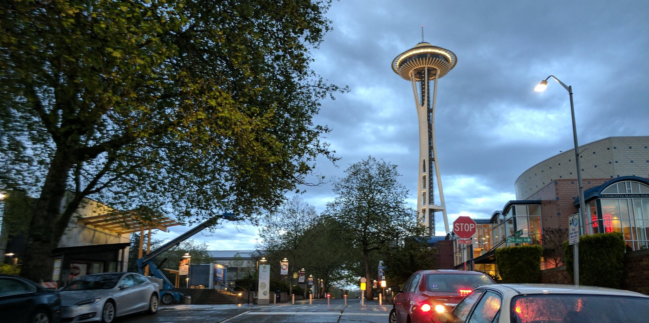
North Downtown Mobility Action Program (NODO MAP)
Investments around North Downtown and the New Arena at Seattle Center
Kay Yesuwan
Community Coordination Committee (C3)
12/05/19

Slide 2
Presentation Overview
NODO Mobility Action Plan finalization
  Scope
  Schedule
  Funding
Highlights on project development process:
  Broad Street Complete Streets
  Protected Intersection at Dexter Ave N / Thomas St
  Seattle Center to Waterfront Greenway
Next Steps
Websites
Notes:
Earlier expenditure of Project F: Monorail Improvements funding to 2020
in anticipation of near-term investments that will allow for better use of this existing transit asset
Deferral of Project D: East Seattle Center to Belltown Bicycle Connection beyond the 10-year implementation horizon;
this project was the lowest priority project included in the draft plan
Earlier opportunity to program the next series of projects;
prior to 2030, staff can start the planning process for “NODO MAP Phase 2: 2030-2040” use of CATF funds
since funding is programmed out for a 10-year horizon, not 20-years as assumed in the draft NODO MAP

Slide 3
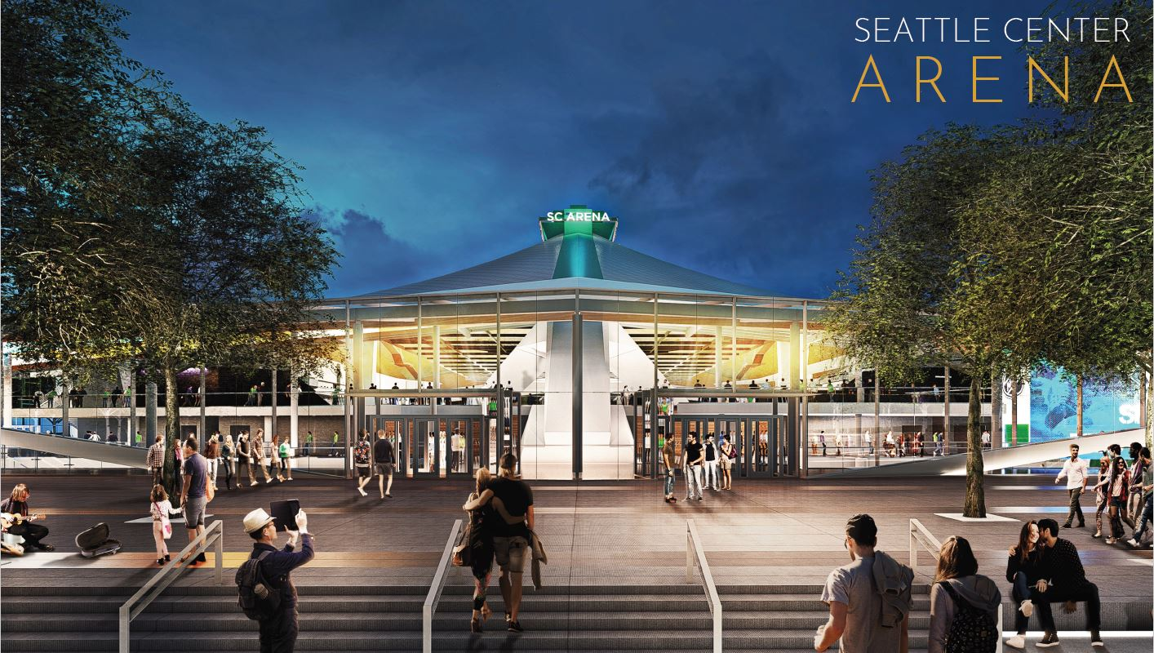
Background and Purpose
Oak View Group (OVG) is required to construct or contribute to transportation projects as part of the SDCI Master Use Permit (MUP) decision
OVG will contribute $40 million over 39 years to a City (Arena) Transportation Fund (CATF) at $1,025,000 per year
North Downtown Mobility Action Plan (NODO MAP) identified and prioritized the recommended projects to be implemented in the Uptown, South Lake Union, and Belltown neighborhoods
Notes:
NODO MAP
In reality, producing a prioritized list of projects specific to this effort
Process kicked-off in October 2017, and the draft recommendations were shared with the public in October 2018
Project was guided by community-developed guiding principles

Slide 4
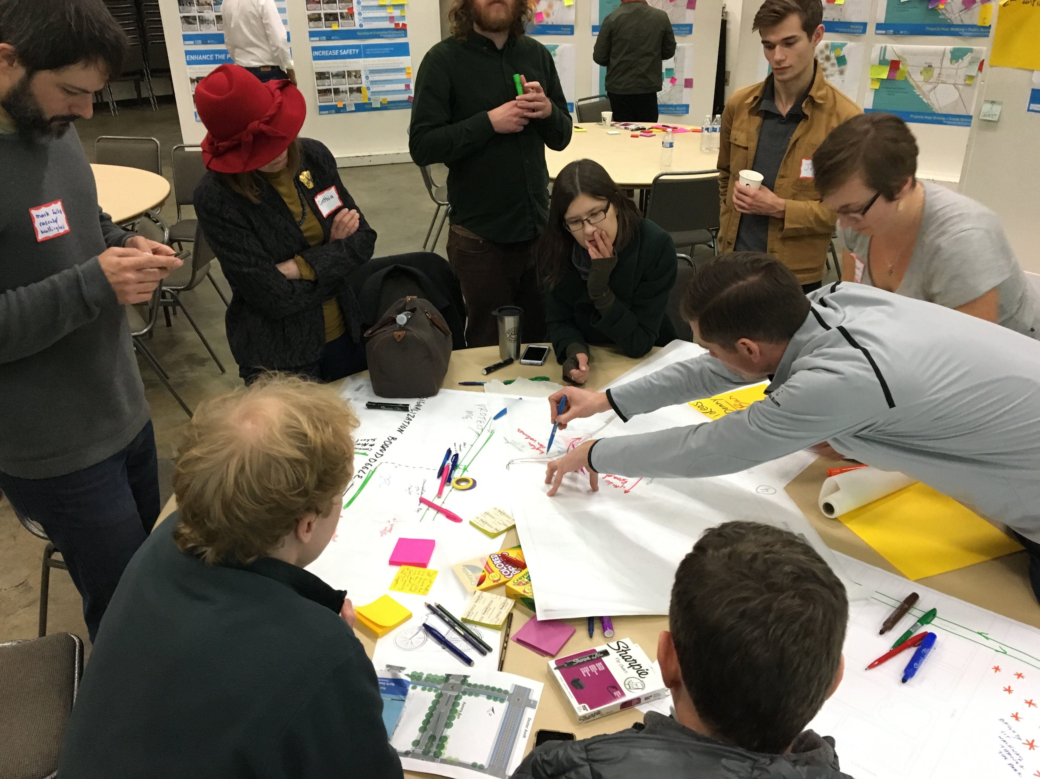
Project Identification, Screening, Evaluation
Oct. 2017 to Oct. 2018
Community engagement for draft NODO Mobility Action Plan
Existing plans
Community input
Arena Transportation and Mobility Subcommittee
Interagency Working Group
System needs identified by SDOT
Went from over 500 project ideas down to 45 Tier 1 projects.
Notes:
Worked with 3 main community groups
Other outreach included:
City Planning Commission and Modal Boards
Neighborhood Intercept Surveys
Senior housing resident and staff conversations
Stakeholder/community briefings and discussions
Open houses and neighborhood meetings
Online engagement map
Walking and biking tours
Went from over 500 project ideas down to 45 Tier 1 projects.
Consolidated and prioritized into the recommended CTF projects
Assess how projects support guiding principals
Utilize technical analysis from the Arena EIS
Apply community input, agency support, system needs
Develop planning-level cost estimates for recommended projects
Came to the Bike Board in Jan 2018

Slide 5
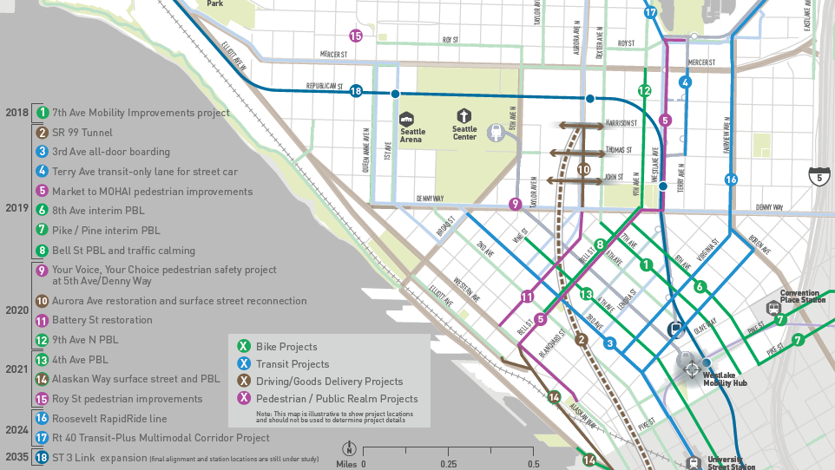
Recent and Upcoming Transportation Projects in North Downtown
Notes:
As background, here are all of the projects already planned and programmed in North Downtown vicinity by SDOT and other partner agencies
Arena MUP Decision and improvements along 1st Ave N and Queen Anne Ave N
Thomas Street Redefined – update to 2013 concept plan
Thomas Street neighborhood greenway
WSDOT SR99 Surface Street Improvement
Denny Way ITS
Seattle Center Skate Park
3rd & Denny Signal Improvement
SCL Broad St Substation
Private development

Slide 6
Arena MUP Decision Projects
Notes:
The Arena MUP decision also includes projects that will make changes in the Arena vicinity:
Contribute funds to adaptive signals in the Arena vicinity
Denny Way, Harrison St, 1st Ave N, QA Ave N
Construct improvements along 1st Ave N and Queen Anne Ave N
Pedestrian improvements
Transit only lanes and a transit queue jump
New signals and signal upgrades
Protected bicycle lanes
Harrison St and 5th Ave N pedestrian improvements
Reconfigure the roadway at 2nd Ave and Denny Way
To allow flushing of post-event garage vehicles
Develop an Arena Access Management Plan (AAMP), which will address how to mitigate transportation impacts during pre- and post-event
Currently in draft form

Slide 7
Changes from Draft NODO MAP recommendations
Project cost increases to reflect contingency, inflation, and outreach
Confirm use of funding sources and partnerships to contribute to projects
Split Project C: Thomas Street Greenway into 2 projects (C1 and C2) to account for different funding sources proposed for the improvements east and west of the Arena
Consolidation of 5 scalable programmatic areas (NODO MAP draft Projects J – N) into a single project Project J: Neighborhood Programmatic Improvements
Notes:
Use of funding sources and partnerships to contribute to projects
Land Conservation and Local Infrastructure Program (LCLIP)
Washington State Department of Transportation (WSDOT) resources
Other SDOT program funding
Project C2: Thomas Street Neighborhood Greenway
Project H: Denny Way Corridor
Project I: Harrison St Corridor
Split Project C: Thomas Street Greenway into 2 projects (C1 and C2)
account for different funding sources proposed for the improvements east and west of the Arena
Project J: Neighborhood Programmatic Improvements
$1M budget
SDOT will continue ongoing coordination with the Arena Community Coordination Committee
confer with the group to prioritize programmatic investments in the 3 neighborhoods
Under this project, additional intersections may be reviewed for pedestrian improvements per neighborhood requests

Slide 8
Changes from Draft NODO MAP recommendations (cont.)
Early expenditure of Project F: Monorail Improvements funding to 2020
Deferral of Project D: East Seattle Center to Belltown Bicycle Connection beyond the 10-year implementation horizon
Earlier opportunity to program the next series of projects
Notes:
Earlier expenditure of Project F: Monorail Improvements funding to 2020
in anticipation of near-term investments that will allow for better use of this existing transit asset
Deferral of Project D: East Seattle Center to Belltown Bicycle Connection beyond the 10-year implementation horizon;
this project was the lowest priority project included in the draft plan
Earlier opportunity to program the next series of projects;
prior to 2030, staff can start the planning process for “NODO MAP Phase 2: 2030-2040” use of CATF funds
since funding is programmed out for a 10-year horizon, not 20-years as assumed in the draft NODO MAP

Slide 9
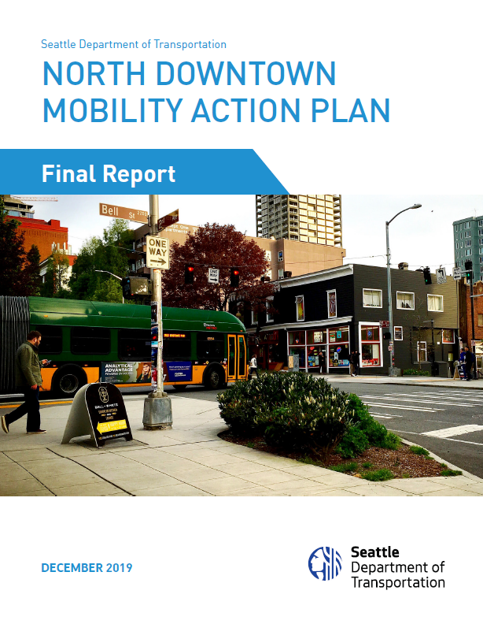
NODO MAP Finalization and Execution Plan Development
Oct. 2018 to Dec. 2019
Prioritize Tier 1 projects
  Assess how projects support guiding principals
  Apply community input, agency support, system needs
  Develop planning-level cost estimates for recommended projects
  Leverage improvements by others
  Determine schedule of projects based on anticipated new arena opening date (mid-2021) and other projects’ schedules
Refine project scope, assume project delivery method, identify team members, refine schedule and cost
Update funding sources and partnerships to contribute to projects
Finalization of NODO Mobility Action Plan (December 2019)
Notes:
Earlier expenditure of Project F: Monorail Improvements funding to 2020
in anticipation of near-term investments that will allow for better use of this existing transit asset
Deferral of Project D: East Seattle Center to Belltown Bicycle Connection beyond the 10-year implementation horizon;
this project was the lowest priority project included in the draft plan
Earlier opportunity to program the next series of projects;
prior to 2030, staff can start the planning process for “NODO MAP Phase 2: 2030-2040” use of CATF funds
since funding is programmed out for a 10-year horizon, not 20-years as assumed in the draft NODO MAP

Slide 10
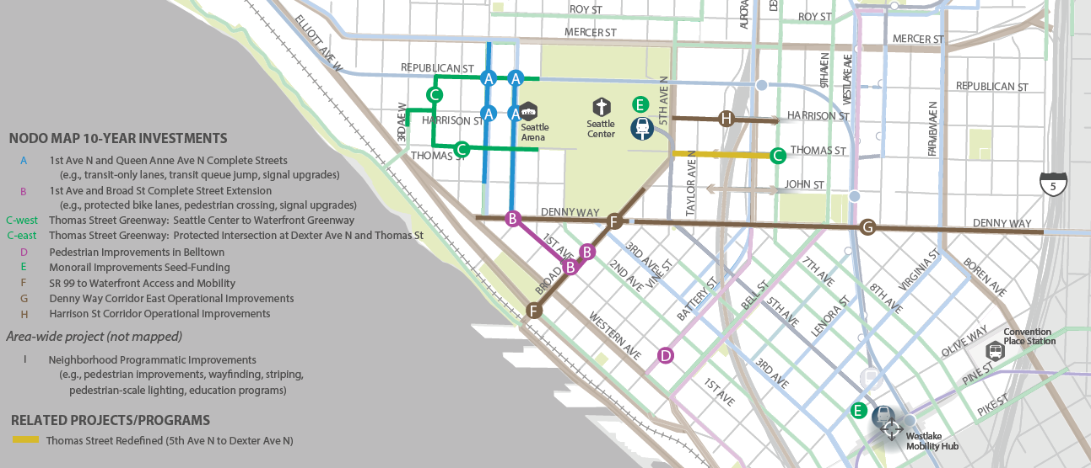
NODO MAP Priority Projects
Notes:
Making multi-modal investments: pedestrian, transit, vehicles (including freight), and bicycle
9 projects and one Neighborhood Programmatic Improvement project

Slide 11
NODO MAP Funding Assumptions
OVG will contribute $40 million over 39 years into a City Arena Transportation Fund → $1,025,000 per year
Different ways to fund projects:
  Leveraging existing SDOT projects and use OVG fund to augment existing funds
  Borrowing amount and then using OVG funding to service the debt over time
  Pay-as-you-go scenario, using OVG funding to closely match work completed per year
Anticipate $9 million in improvements between now and 2021, and $28 million in the first 10 years when combined with existing programs, mitigation resources and other funding sources.
Notes:
6 known funding sources

Slide 12
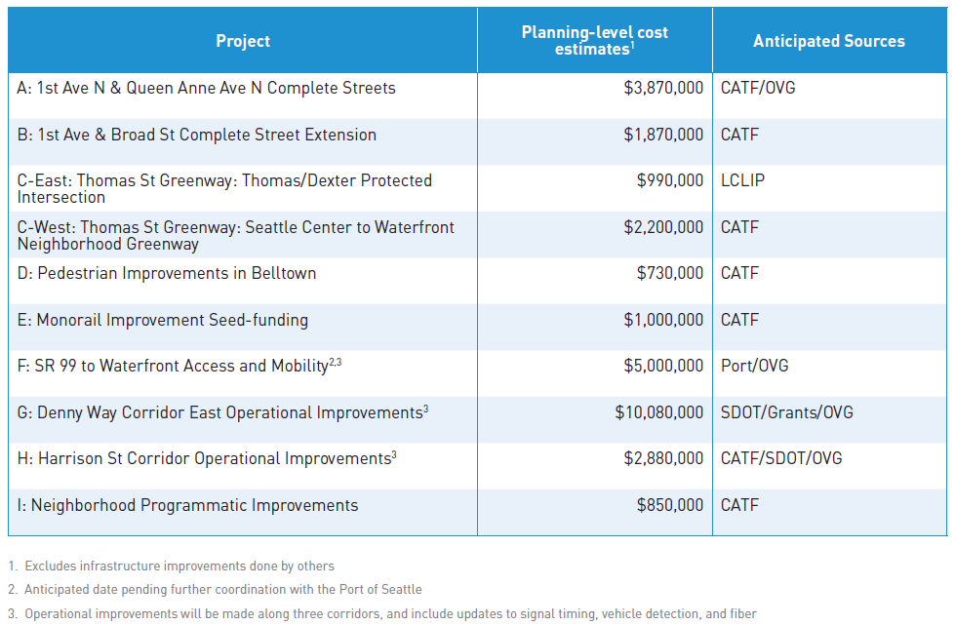
NODO MAP Funding Assumptions
Notes:
6 known funding sources

Slide 13
NODO MAP Project by Funding (DRAFT)
Notes:
6 known funding sources

Slide 14
NODO MAP Priority Projects
Notes:
Initial 10-year project listing
Port of Seattle are partners for Broad St
6 known funding sources

Slide 15
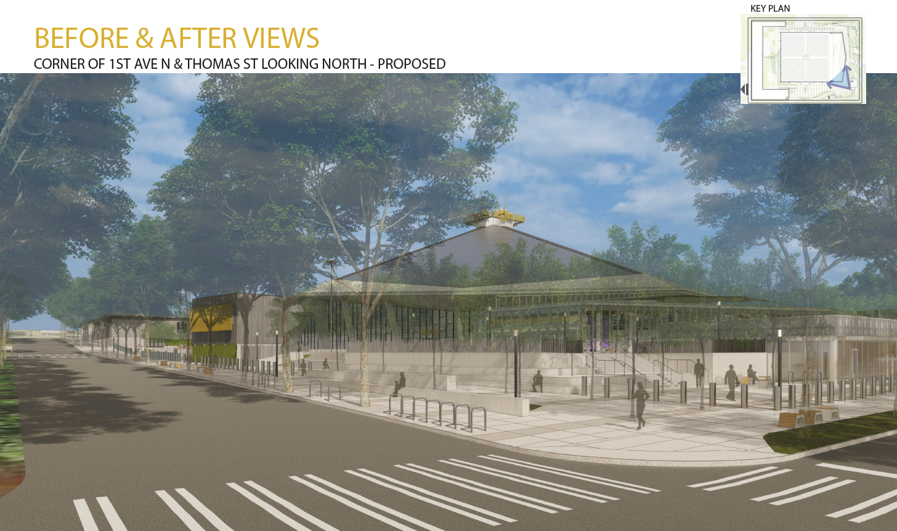
Highlights of Project A: 1st & Queen Anne Ave Complete Streets
Redesign 1st Ave N and Queen Anne Ave N
  Transit-only lanes
  Transit queue jump
  Two new signals
  Curb bulbs
  Widen crosswalks
  2-way PBLs
Ensure mobility and safety
  Adaptive signal system
Notes:
1st Ave N and Queen Anne Ave N are key north-south corridors that connect Belltown and Uptown and serve the front door of the Seattle Center arena.
Prioritize people taking transit, walking, and bicycling by including transit-only lanes, protected bicycle lanes, and pedestrian improvements.

Slide 16
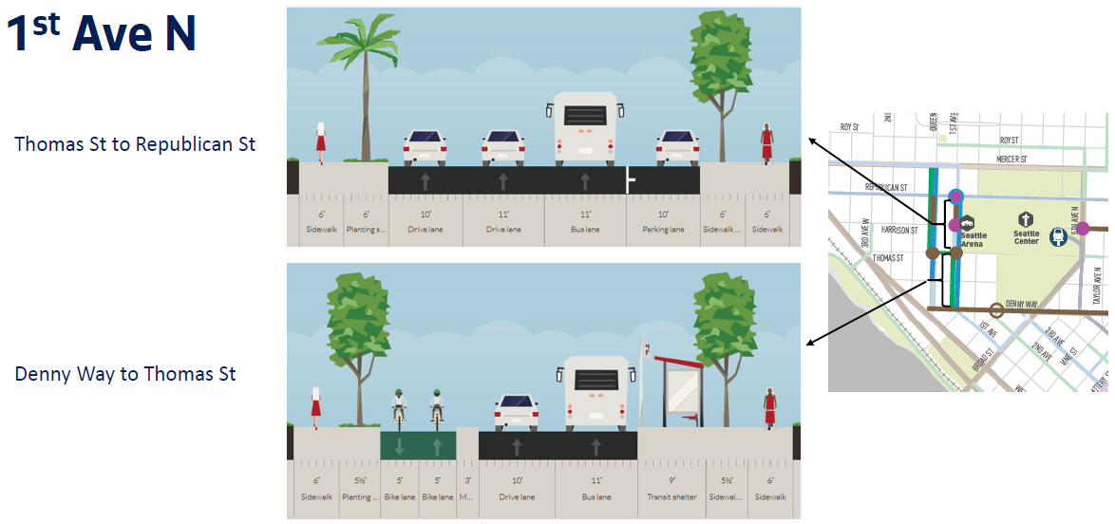
Highlights of Project A: 1st & Queen Anne Ave Complete Streets
Redesign 1st Ave N and Queen Anne Ave N
  Transit-only lanes
  Transit queue jump
  Two new signals
  Curb bulbs
  Widen crosswalks
  2-way PBLs
Ensure mobility and safety
  Adaptive signal system
Notes:
1st Ave N and Queen Anne Ave N are key north-south corridors that connect Belltown and Uptown and serve the front door of the Seattle Center arena.
Prioritize people taking transit, walking, and bicycling by including transit-only lanes, protected bicycle lanes, and pedestrian improvements.

Slide 17
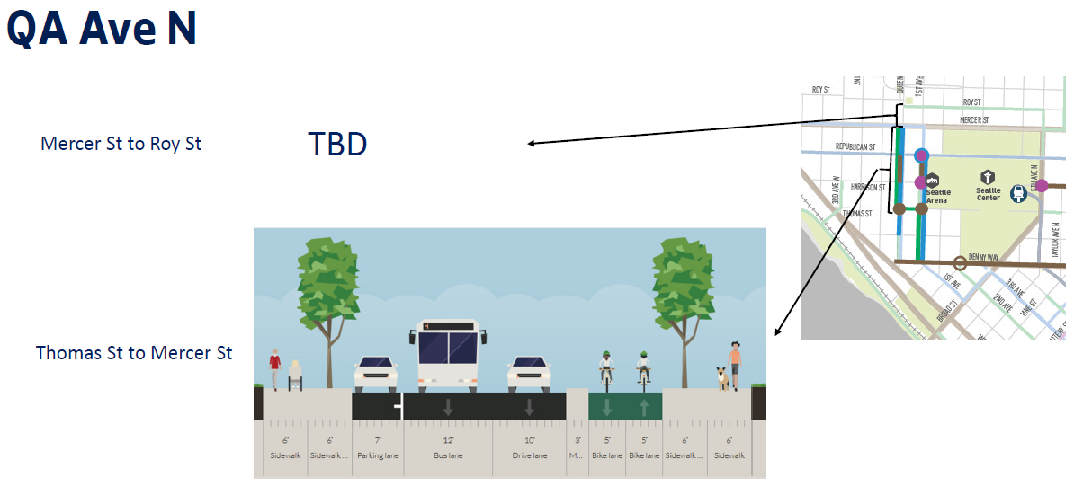
Highlights of Project A: 1st & Queen Anne Ave Complete Streets
Notes:
1st Ave N and Queen Anne Ave N are key north-south corridors that connect Belltown and Uptown and serve the front door of the Seattle Center arena.
Prioritize people taking transit, walking, and bicycling by including transit-only lanes, protected bicycle lanes, and pedestrian improvements.

Slide 18
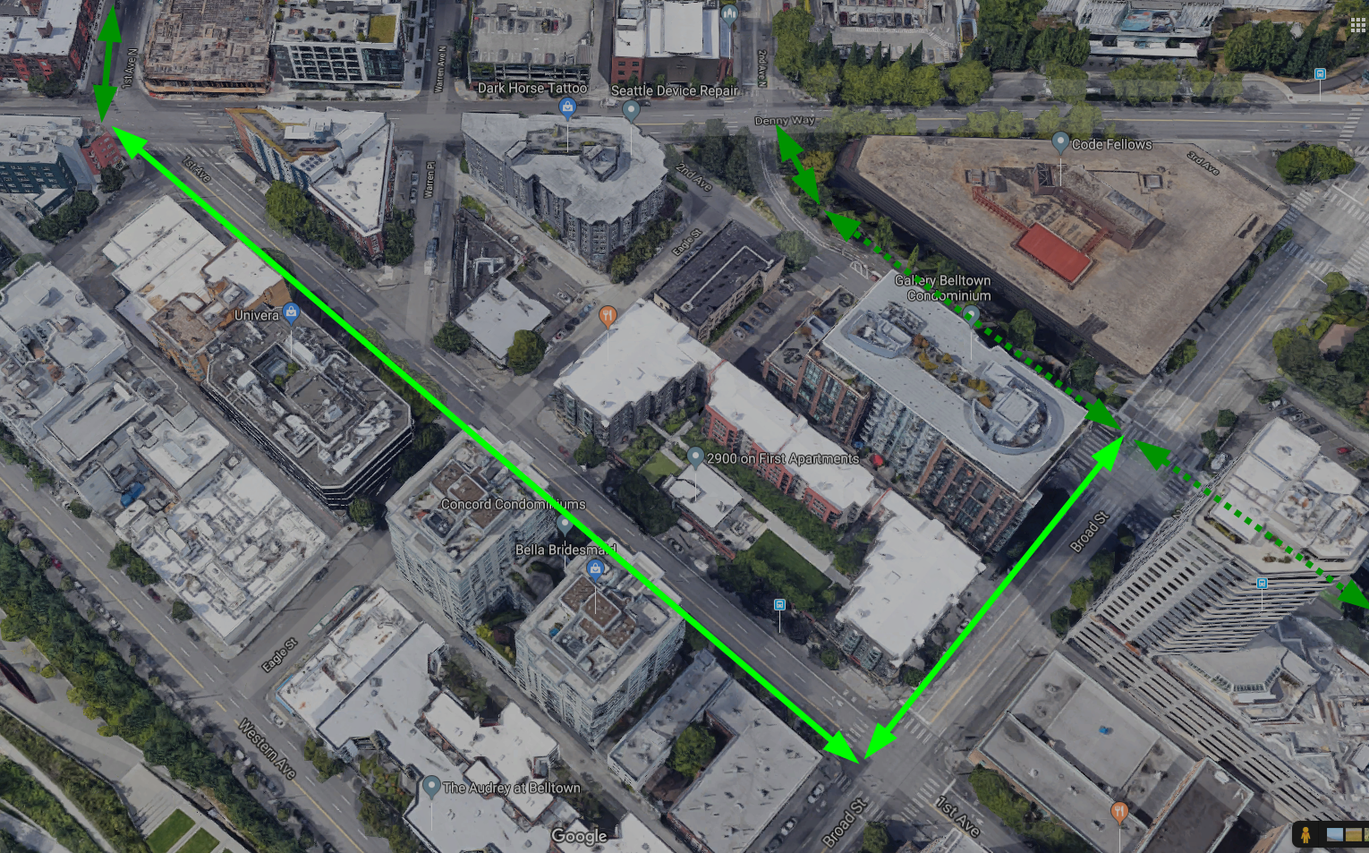
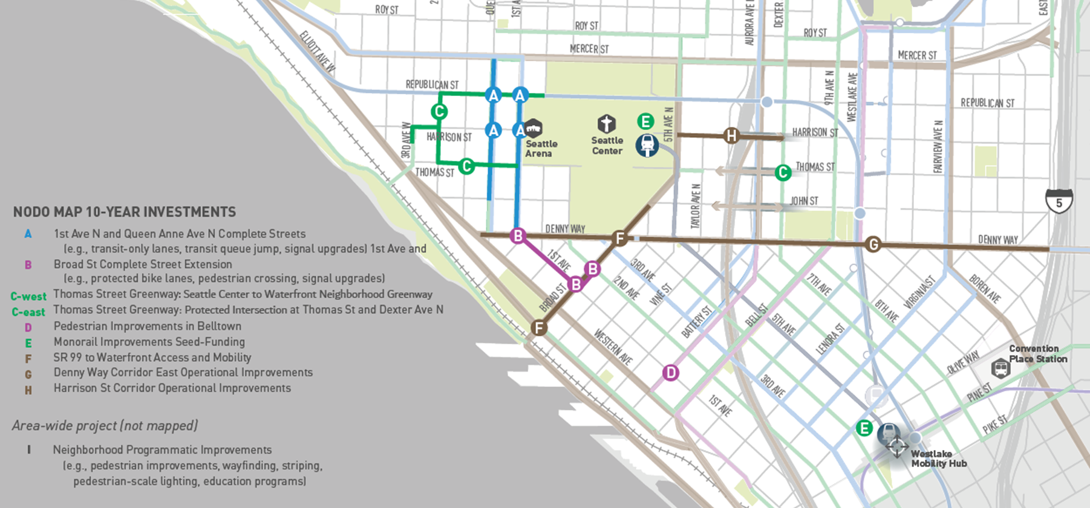
Highlights of Project B: 1st & Broad St Complete Street Extension
Modification of 2nd Ave PBL by OVG to allow for 2-thru lanes on 2nd Ave for arena garage flush post-event
Leverage improvements to complete bicycle connection from 2nd and Broad to new PBL at 1st Ave N
Challenges:
  Freight route
  Transit impacts
  Signals
  Coordination with Denny Way ITS Project
  Operational analysis of route
Notes:
Operational analysis of PBL route wrt to 1st/Denny, 1st/Broad, and 2nd/Broad signal, transit, general purpose, and freight operations

Slide 19
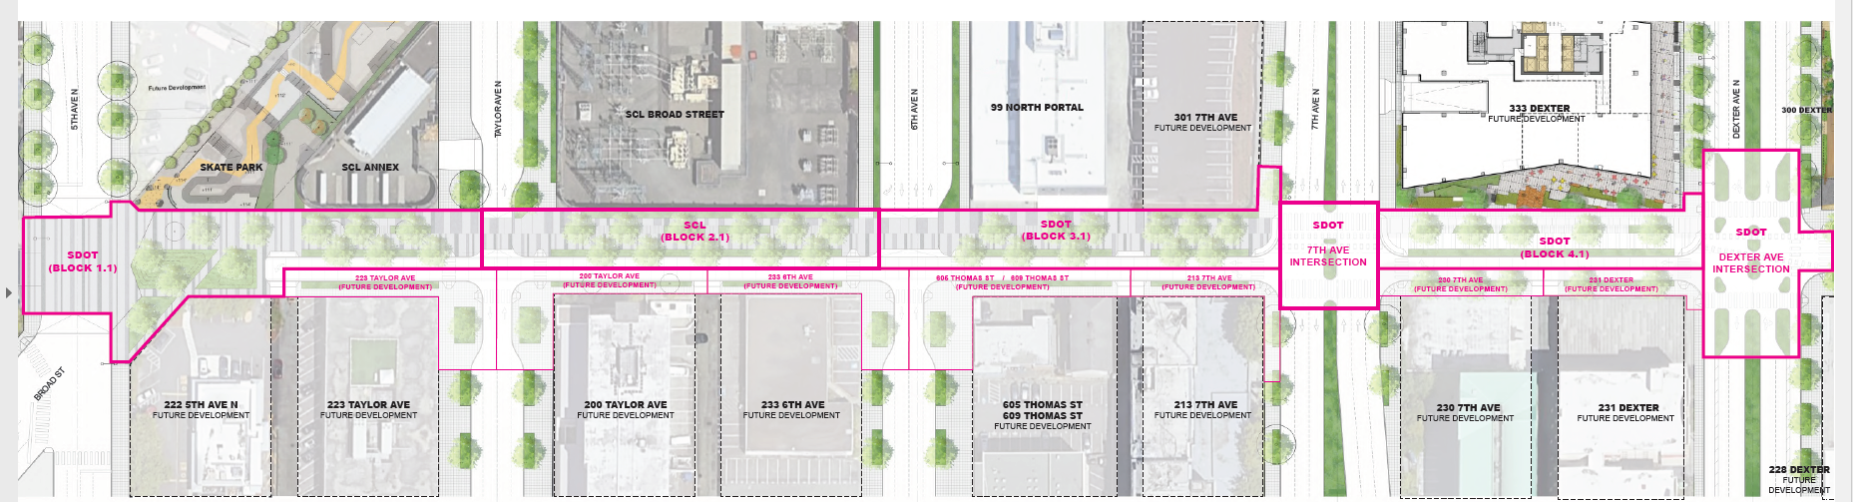
Thomas Street Redefined: 3 Key Transformative Elements
Plaza connecting Seattle Center
  Skate park connection
  Half Block closure 5th to alley
North Promenade Cross-Section
  36’ pedestrian and bicycle promenade
  Multi-use pathway, sidewalk and landscaping
  18’ roadway
Dexter Ave Protected Intersection
  Bike facility connection
  Transit connection

Slide 20
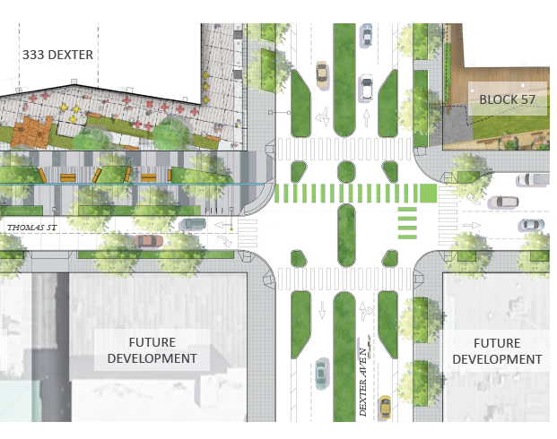
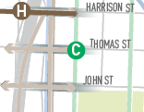
Highlights of Project C-East: Dexter/Thomas Protected Intersection
Leverage the reconstruction of Thomas St across 7th Ave to facilitate east-west pedestrian and bicycle travel between South Lake Union and Uptown.
Associated with Thomas Street Redefined
Challenges:
  Active development in intersection
  Coordination with WSDOT construction, SCL design, private development
  Interim/early, permanent improvements
Notes:
Not in original NODO MAP plan. Originally was going to be signal for ped/bike crossing, but further outreach from public led to Thomas St Redefined (updated concept plan).
Reviewing adopted budget which included Council budget actions for Thomas St funding, may be specific to east of Seattle Center.

Slide 21
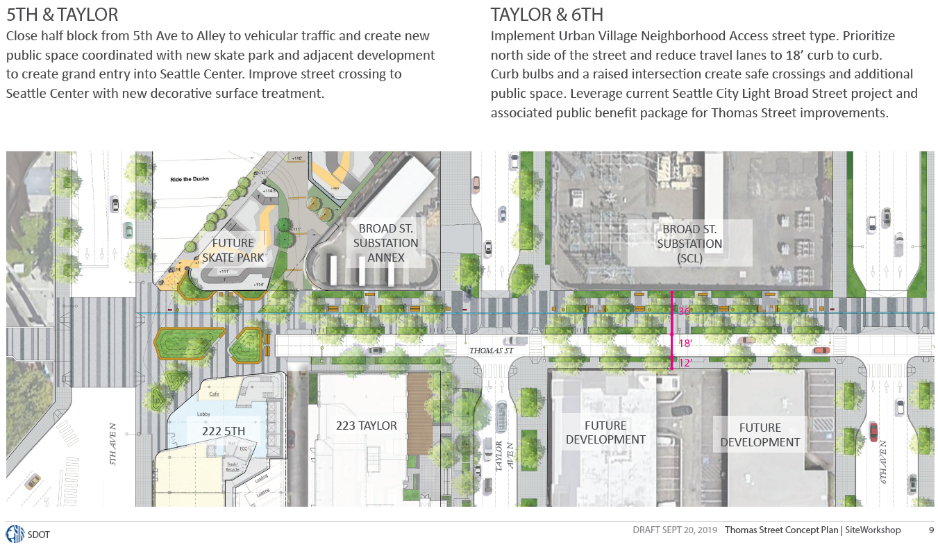
Highlights of Thomas Street Redefined

Slide 22
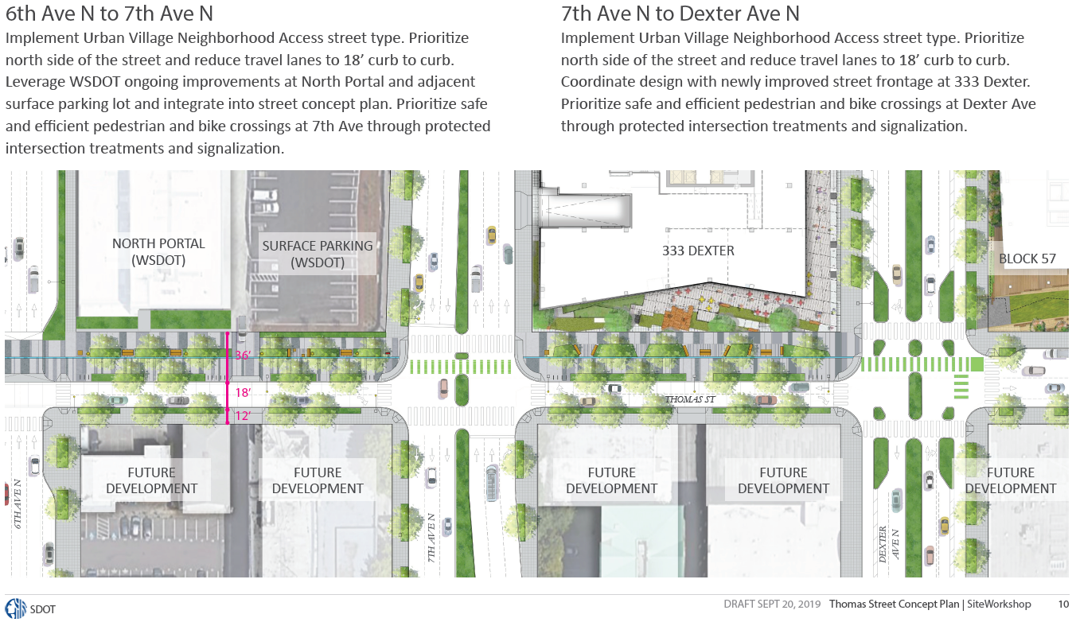
Highlights of Thomas Street Redefined

Slide 23
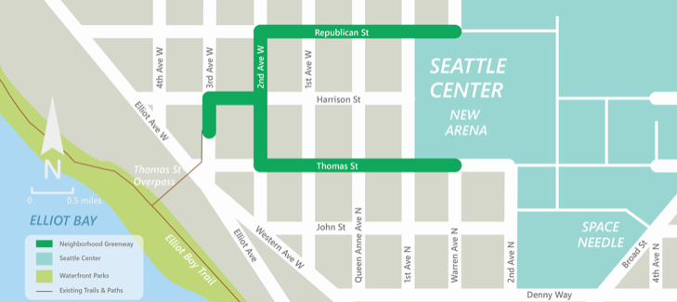
Highlights of Project C-West: Seattle Center to Waterfront NGW
Improve and highlight the route people use to walk and bike between the central waterfront and Seattle Center via the Thomas Street overpass
Leverage improvements by OVG at 1st /Thomas and QA/Thomas
Coordinate with Thomas Street Redefined – concept plan
Advance baseline design schedule with intent to meet arena opening date
Notes:
1st Ave N and Queen Anne Ave N are key north-south corridors that connect Belltown and Uptown and serve the front door of the Seattle Center arena.
Prioritize people taking transit, walking, and bicycling by including transit-only lanes, protected bicycle lanes, and pedestrian improvements.
Route selection was through the NODO outreach process with follow up on slope analysis
Reviewing all-stop warrants for NGW guidance
Keep speeds low
Help people cross busy streets

Slide 24
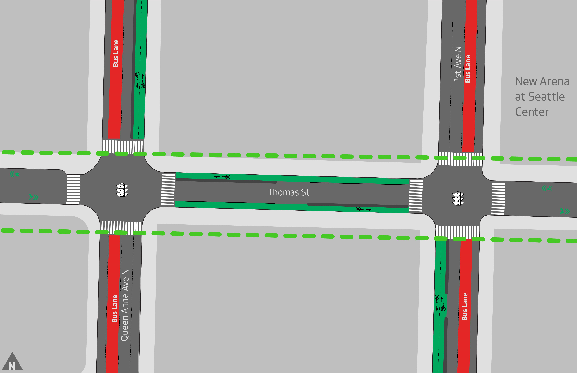
Highlights of Project C-West: Seattle Center to Waterfront NGW
THOMAS ST BETWEEN 1ST AVE N & QA AVE N – TRAFFIC, SIGNALS, AND PBL OPERATION REVIEW
Notes:
Reviewing new neighborhood greenway in coordination with 2-way PBLs by OVG
Signal timing and phasing
Segment is part of Thomas St Redefined but these improvements are what is needed for 2021 opening for PBLs.

Slide 25
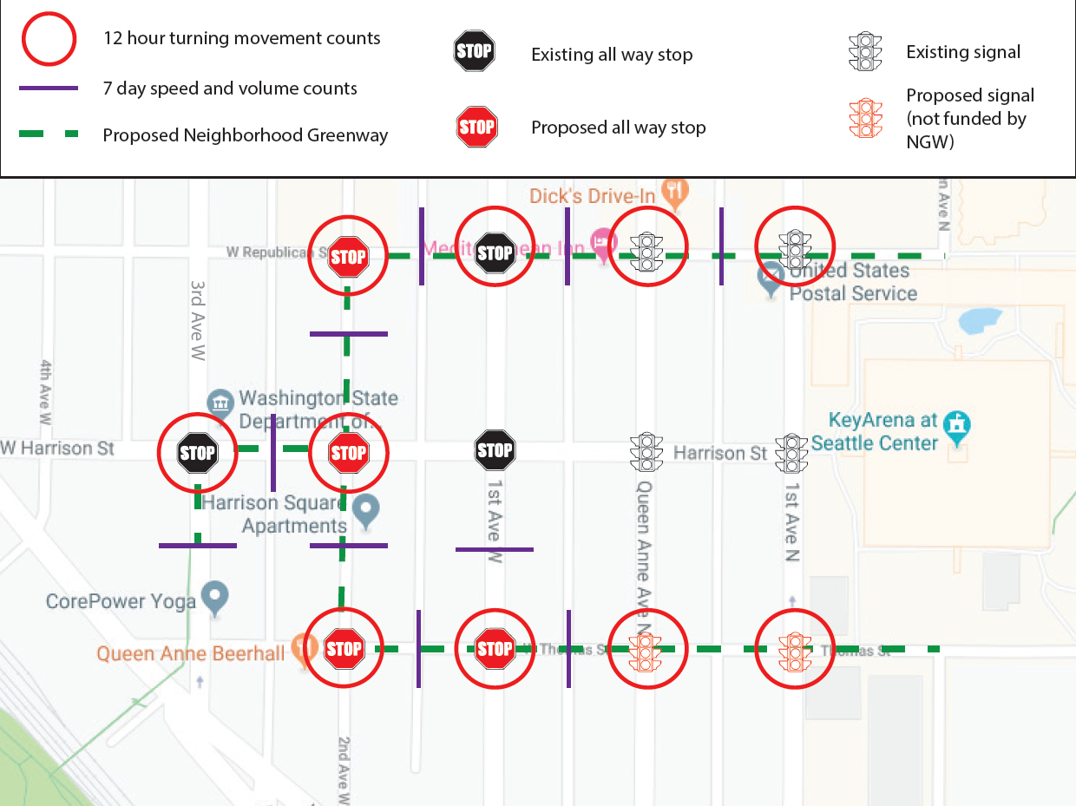
Highlights of Project C-West: Seattle Center to Waterfront NGW
Collect existing speed and volume count
Review existing locations of all-way stops
Determine warrants for proposed all-way stops
SDOT is also reviewing for all-way stops in between Denny Way and Mercer St, from Elliott Ave W to Seattle Center

Slide 26
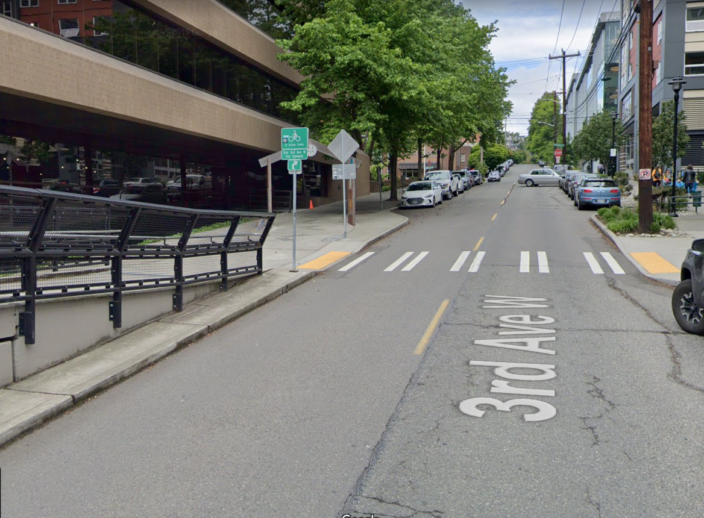
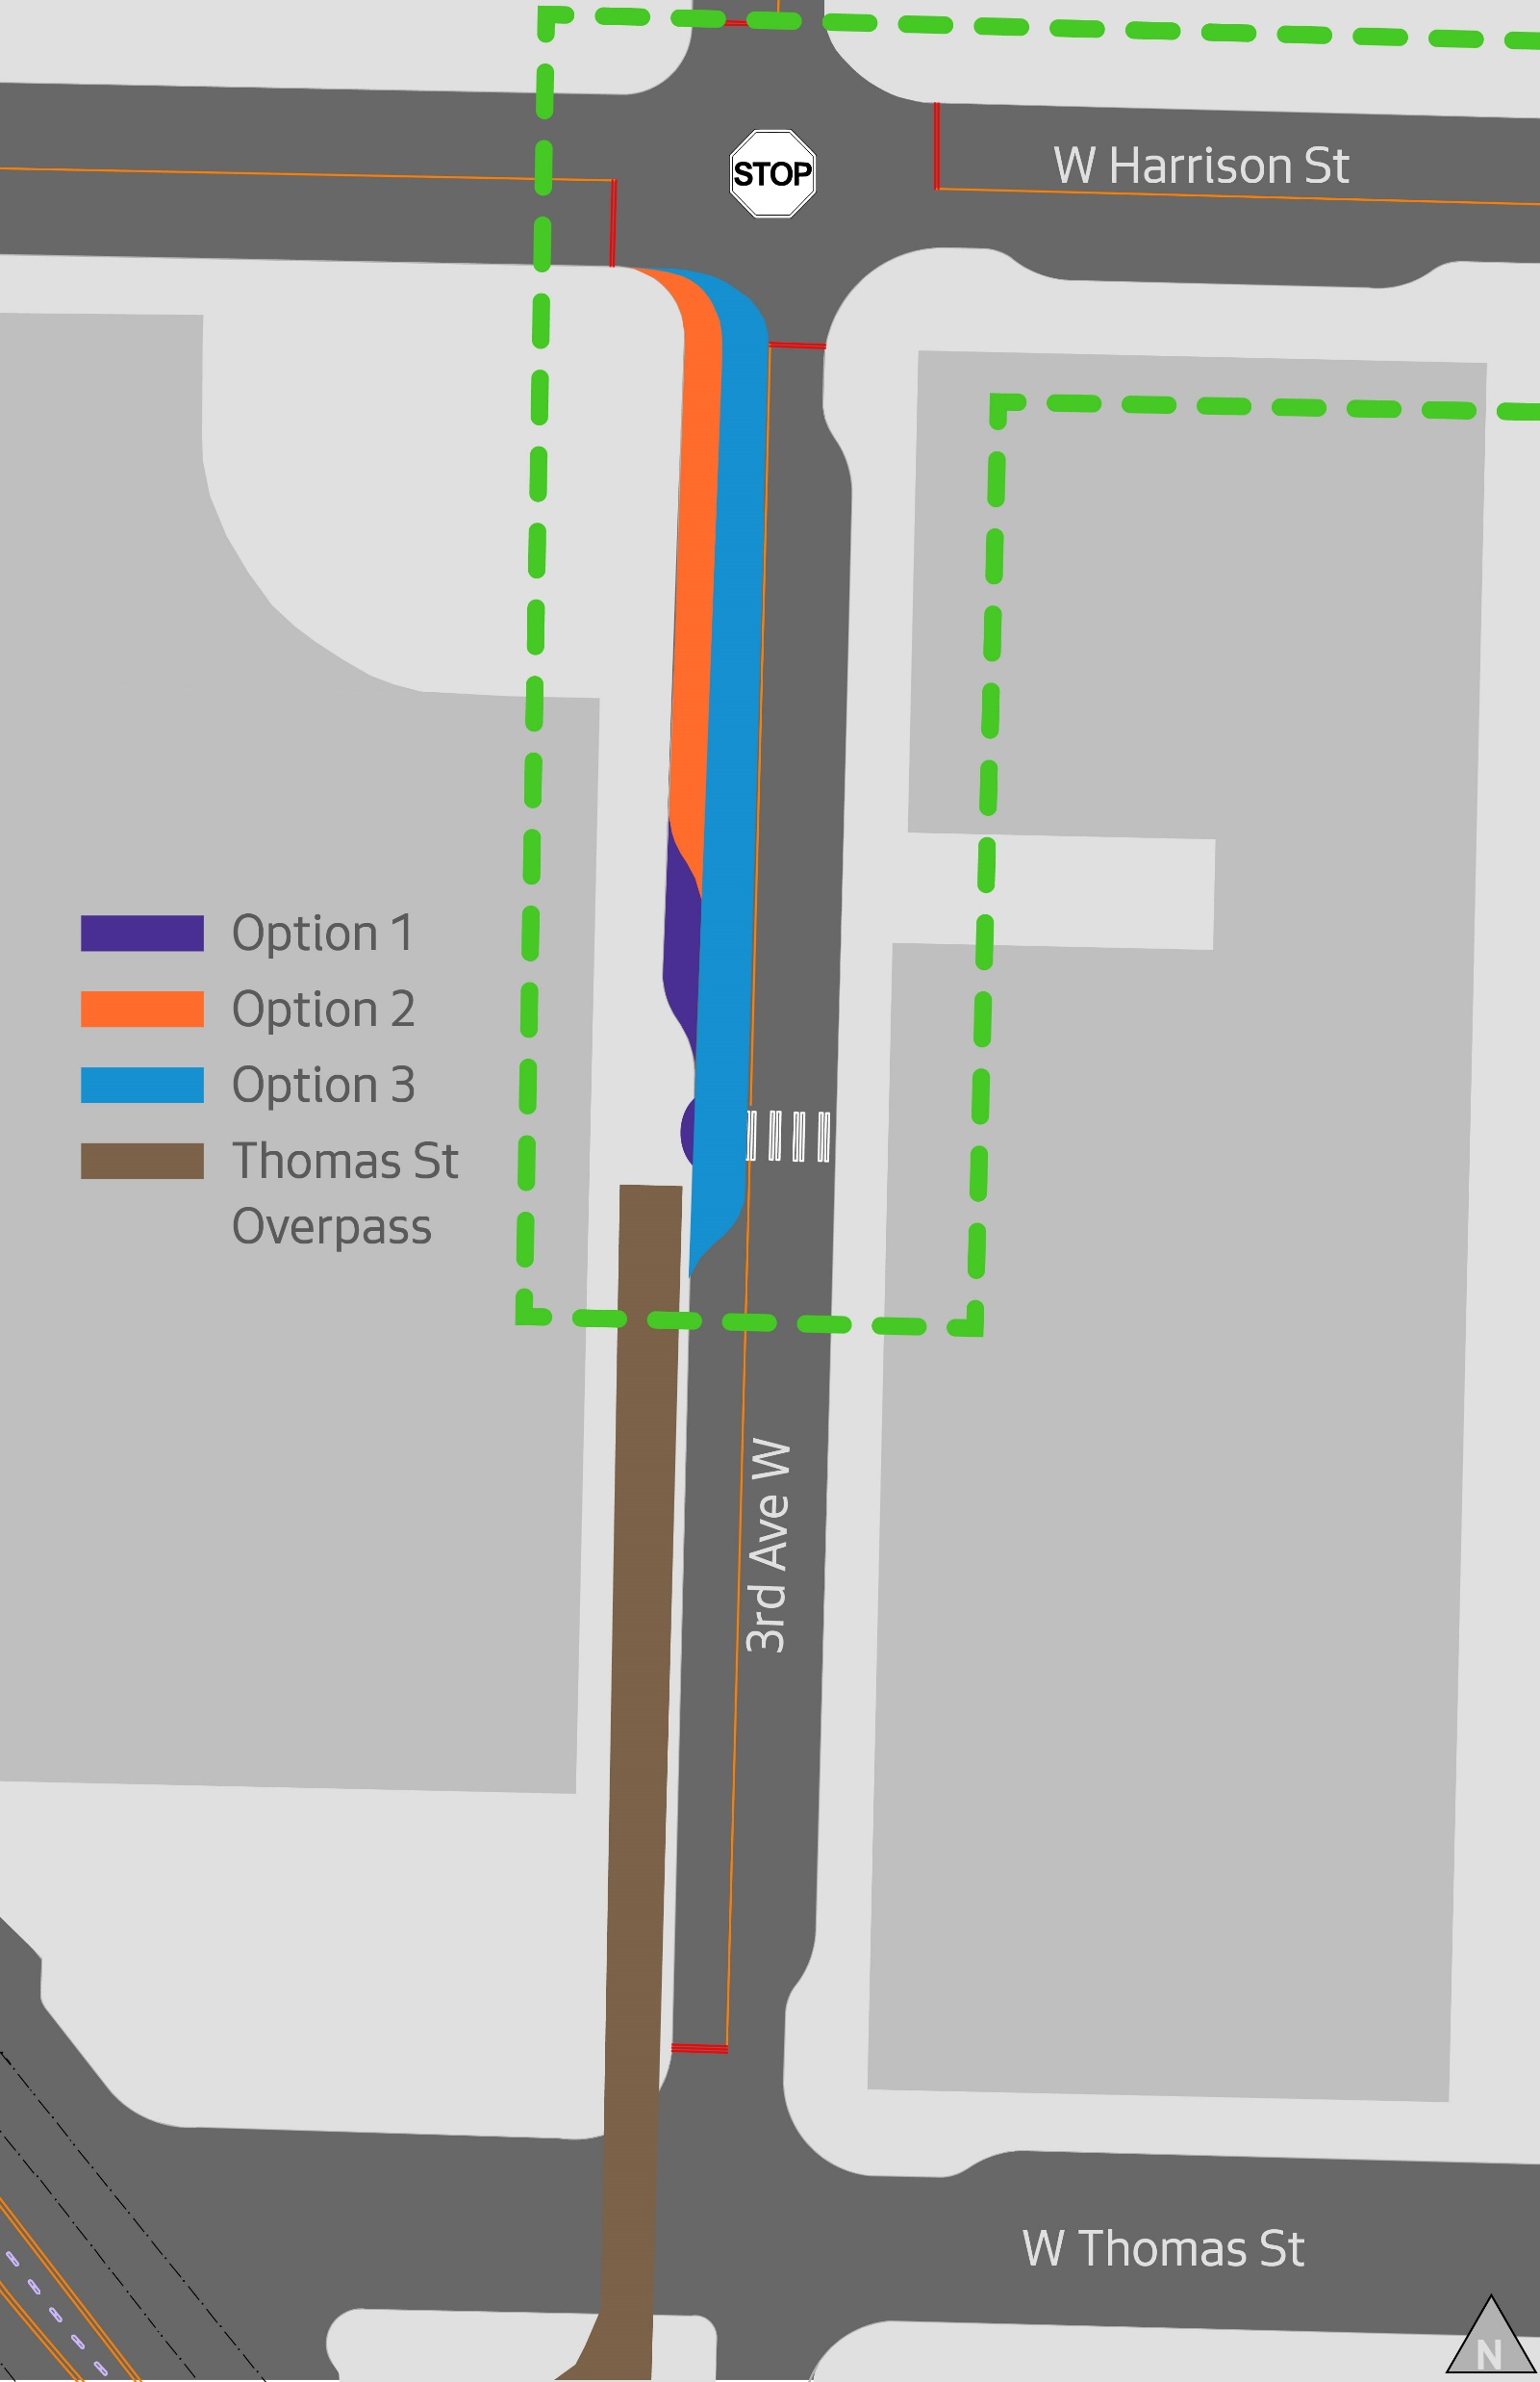
Highlights of Project C-West: Seattle Center to Waterfront NGW
REVIEWING OPTIONS FOR EASIER ACCESS ON AND OFF THOMAS ST OVERPASS
Notes:
3 options that team is currently reviewing
Further outreach to be conducted

Slide 27
Next Steps
Action Item
Continue stakeholder engagement | Ongoing
Complete Thomas St Redefined Concept Plan from Elliott to Eastlake | Q1 2020
Construct Interim Changes 5th Ave N & Thomas St – Half Block Closure Dexter Ave N & Thomas St – Right In/Right Out Diverter | Q1 2020
Advance Thomas St Redefined Design concepts at: 5th Ave N to Taylor Ave N along Thomas 6th Ave N to 7th Ave N along Thomas (adapt WSDOT work on northern block face) Dexter to Terry | Design 2020
Advance design of Dexter & Thomas Protected Intersection | Construction 2021
Advance design of Seattle Center to Waterfront Neighborhood Greenway | Construction 2021
Advance design of Broad Street Complete Streets | Construction 2021
Notes:
Extend E of Dexter – next phase. Mercer Mega Block

Slide 28
Websites
NODO MAP
  https://www.seattle.gov/transportation/NODOMAP
Thomas Street Redefined
  https://www.seattle.gov/transportation/projects-and-programs/programs/urban-design-program/street-design-concept-plans/thomas-street-redefined
Seattle Center to Waterfront NGW
  https://www.seattle.gov/transportation/projects-and-programs/programs/greenways-program/seattle-center-to-waterfront-greenway
Notes:
Earlier expenditure of Project F: Monorail Improvements funding to 2020
in anticipation of near-term investments that will allow for better use of this existing transit asset
Deferral of Project D: East Seattle Center to Belltown Bicycle Connection beyond the 10-year implementation horizon;
this project was the lowest priority project included in the draft plan
Earlier opportunity to program the next series of projects;
prior to 2030, staff can start the planning process for “NODO MAP Phase 2: 2030-2040” use of CATF funds
since funding is programmed out for a 10-year horizon, not 20-years as assumed in the draft NODO MAP

Slide 29
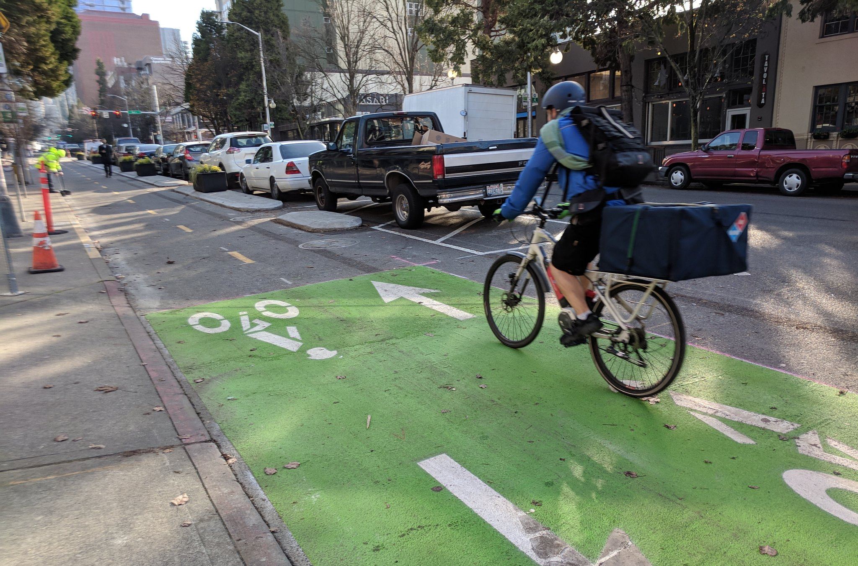
Comments/Questions?

